Slide 1
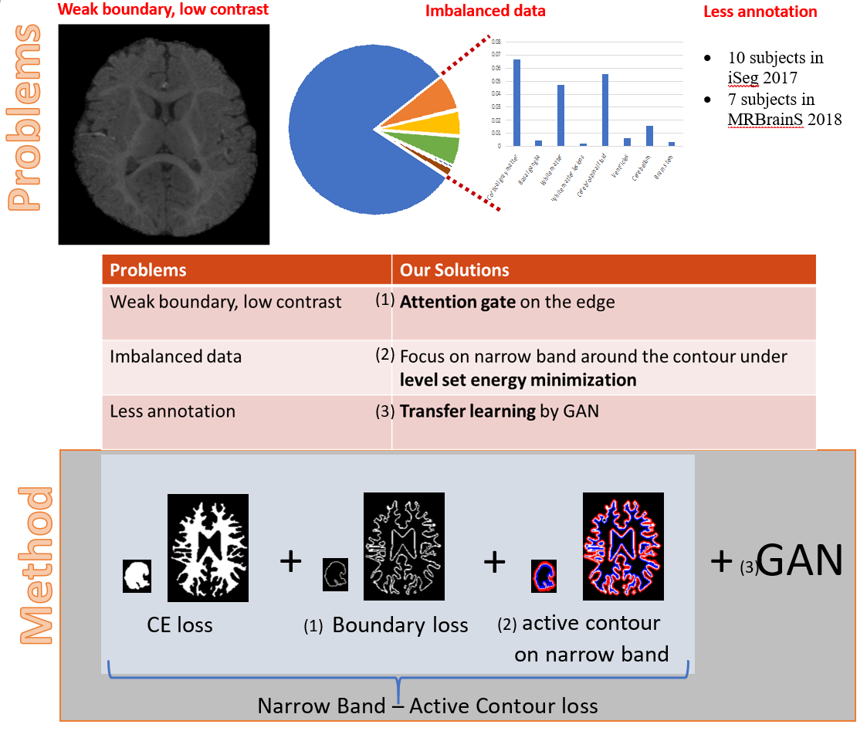
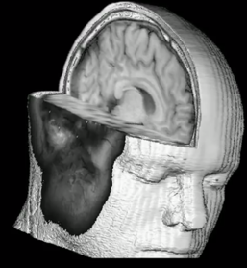
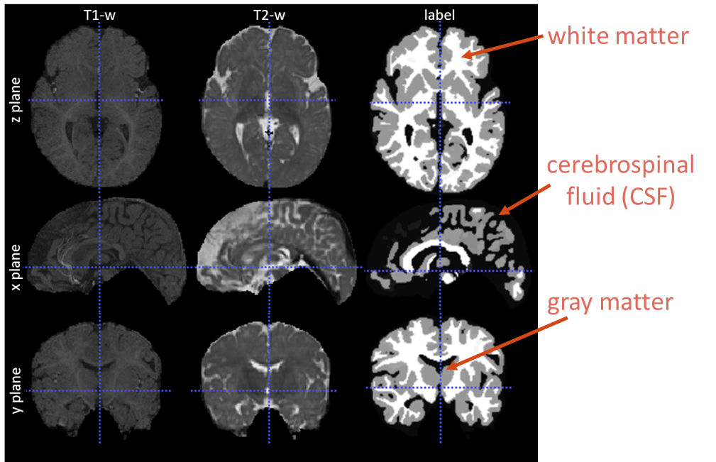
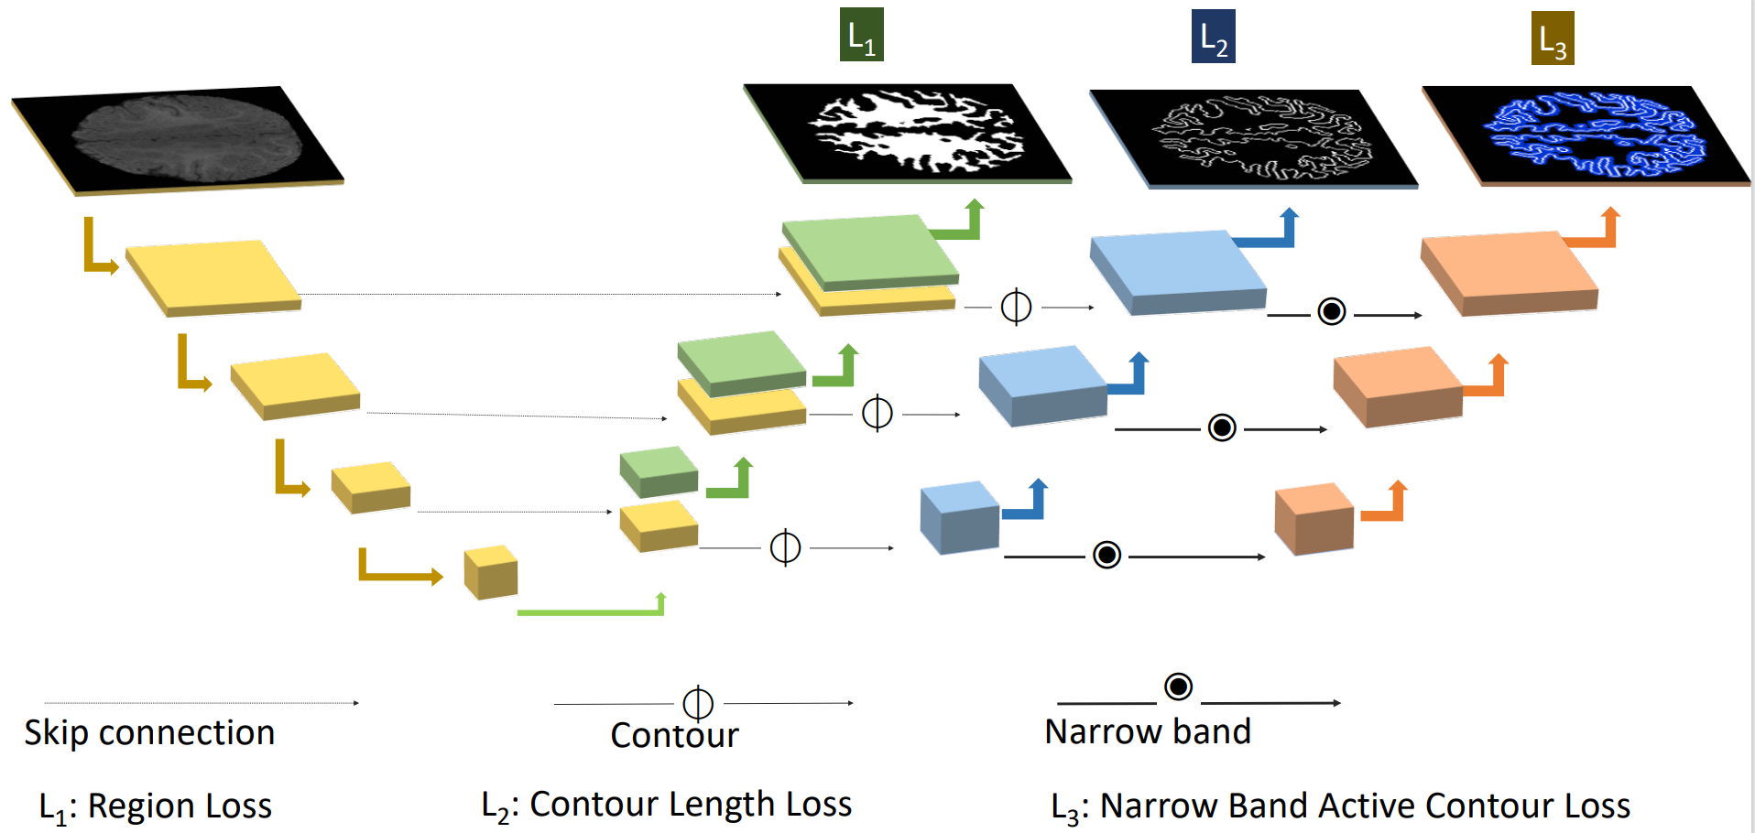
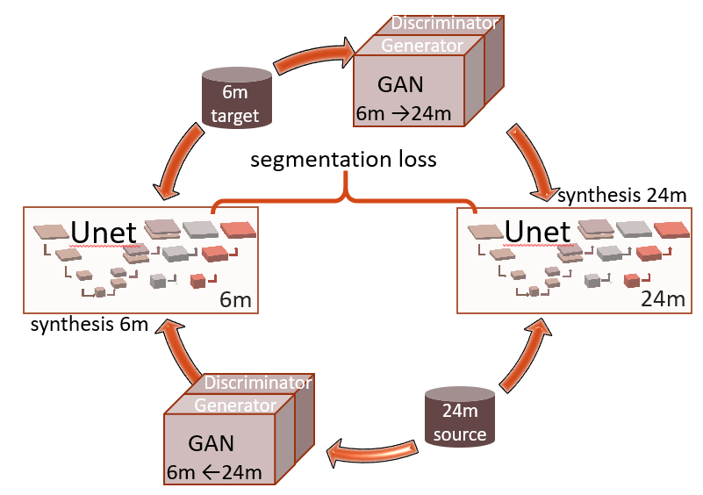
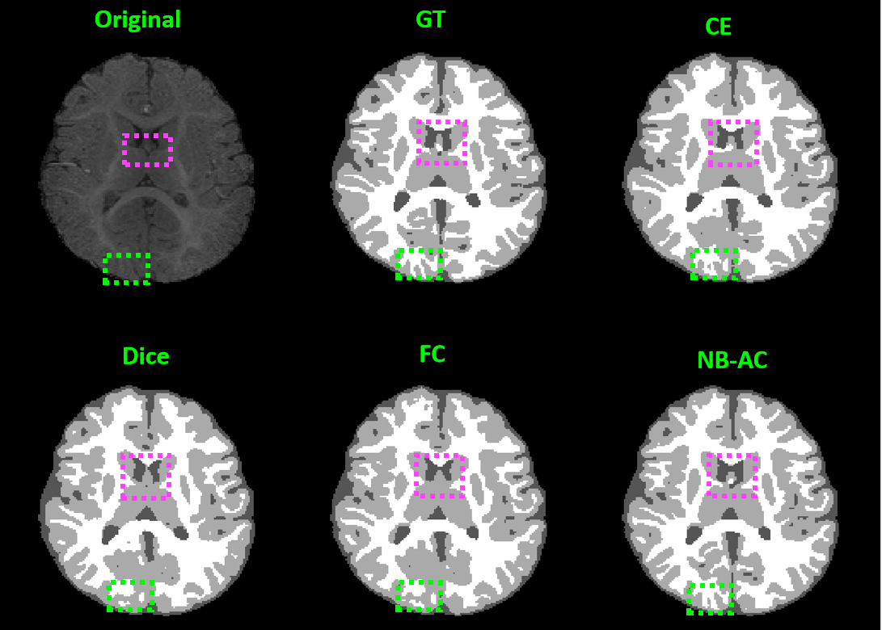
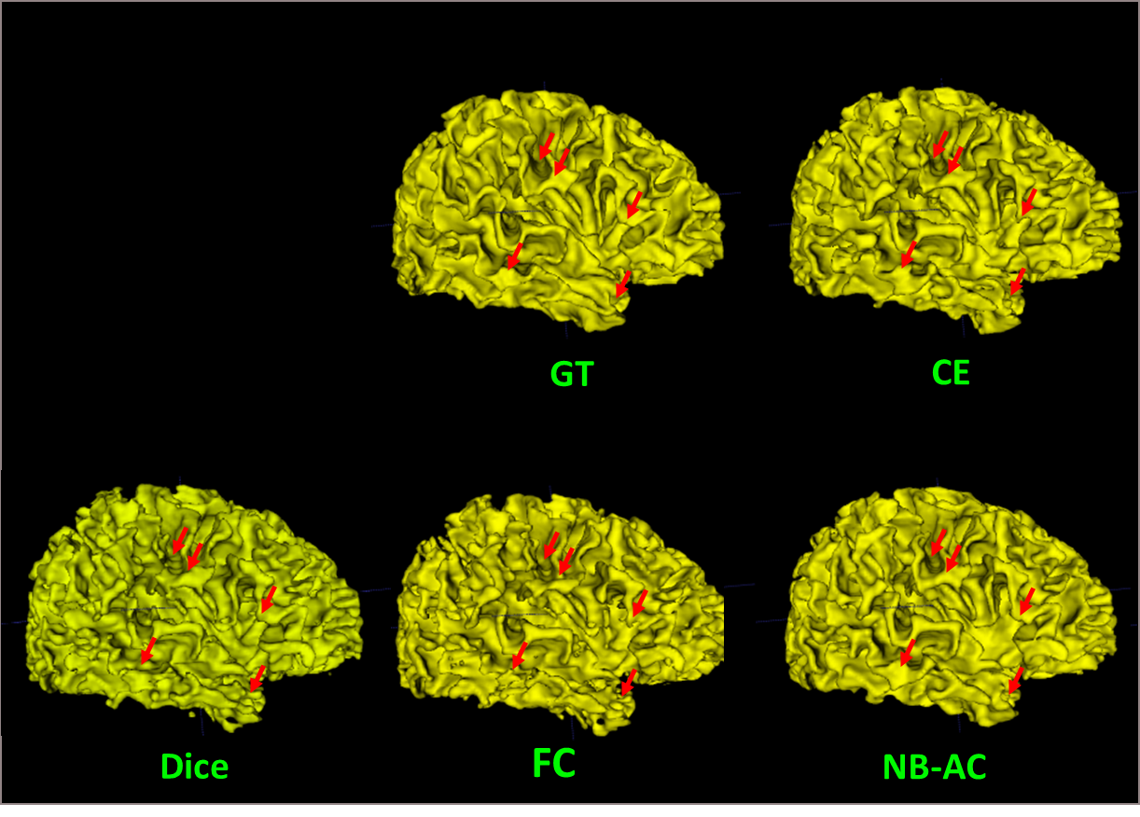
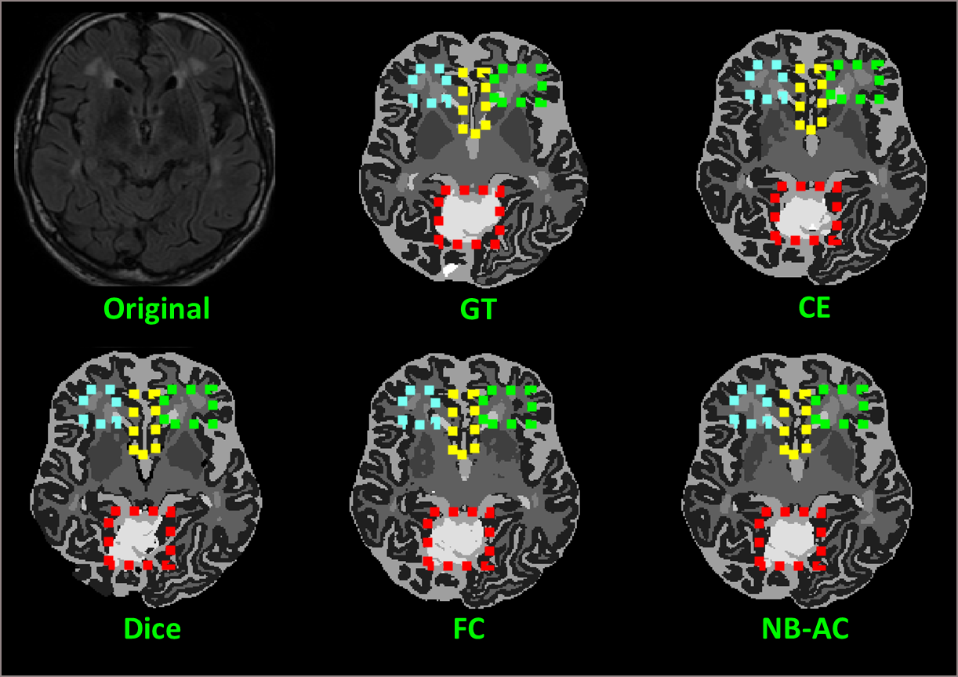
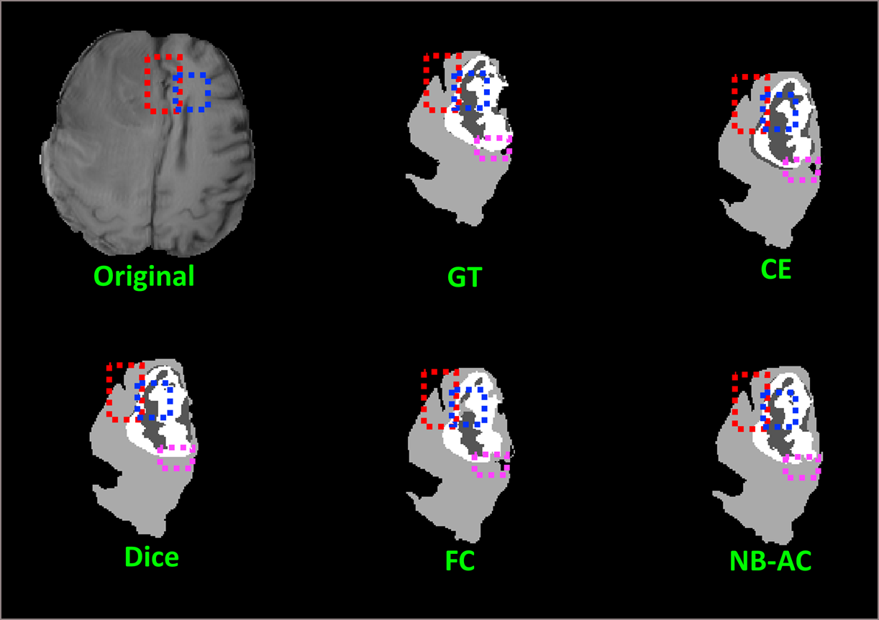
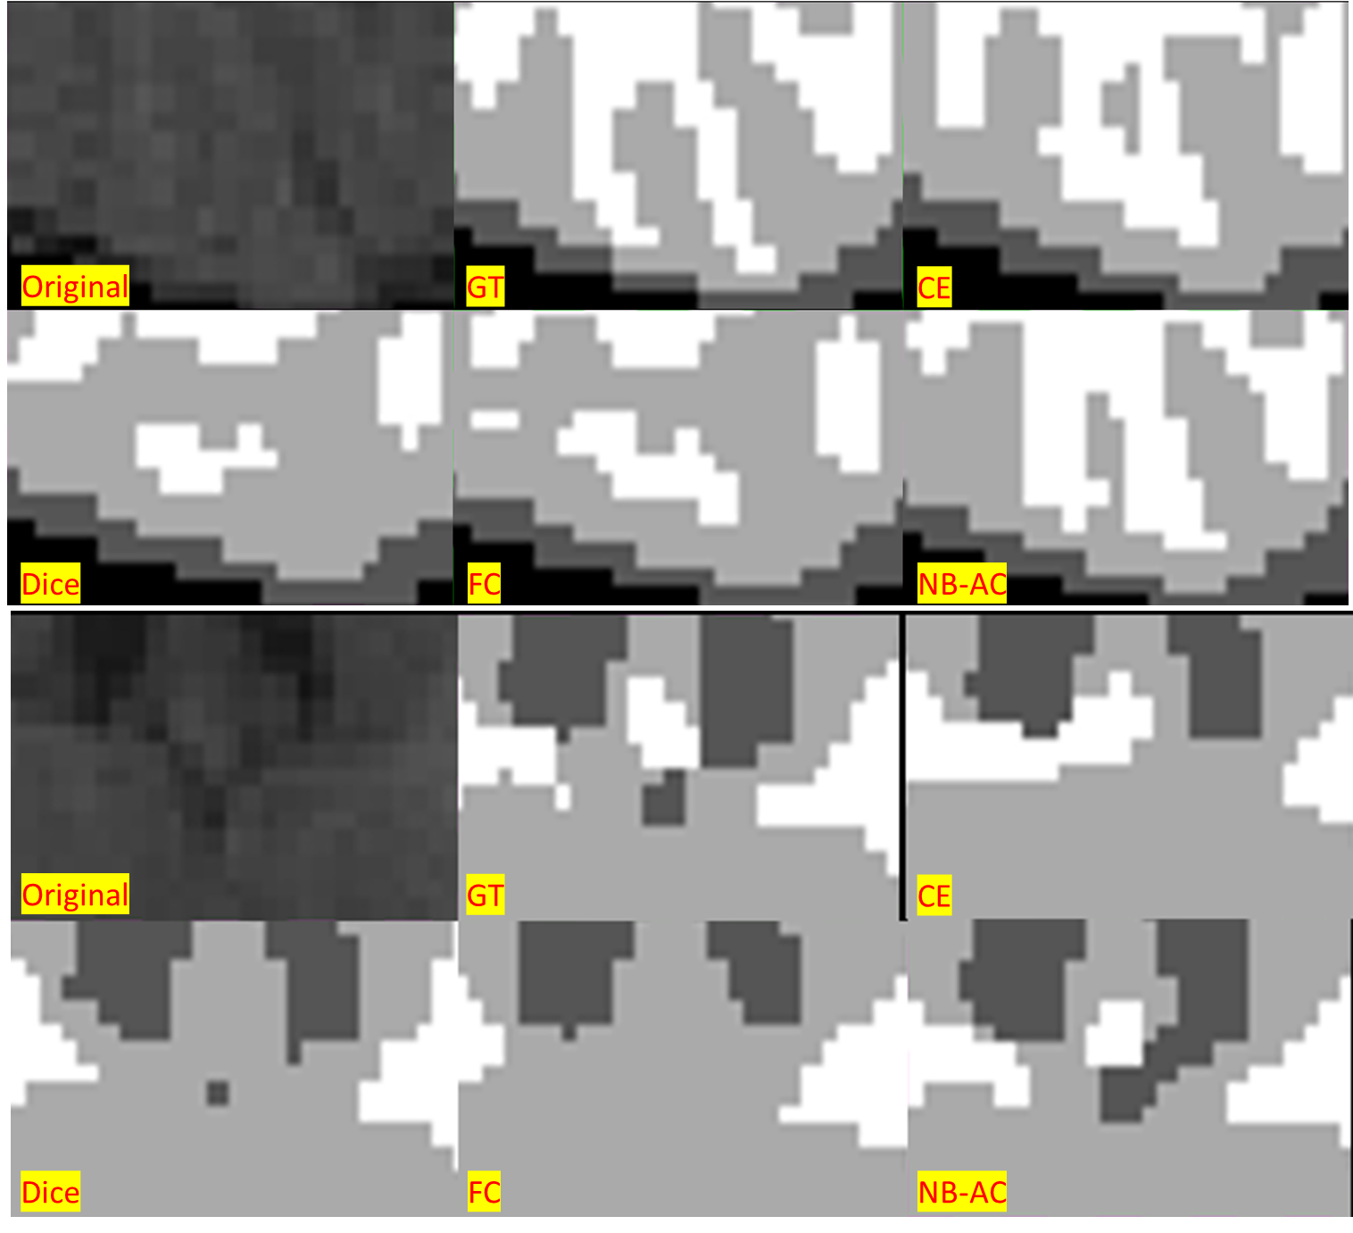
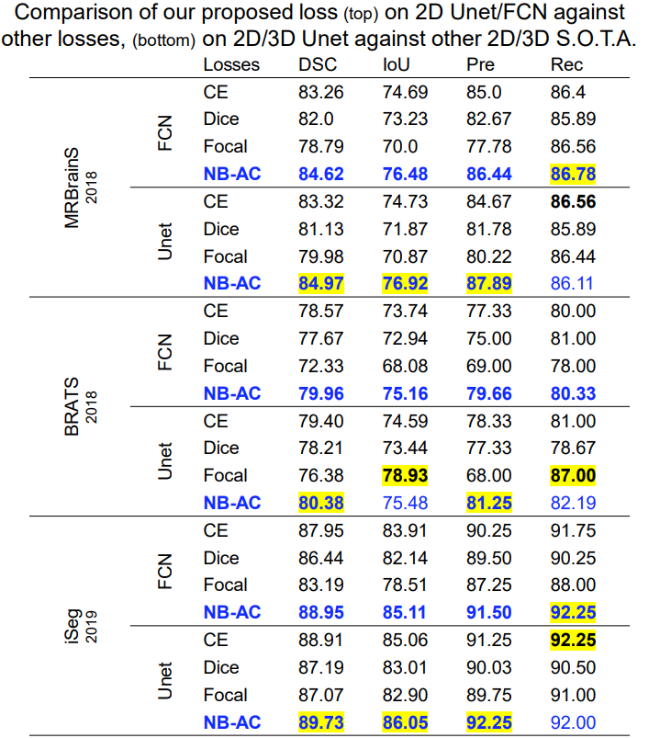
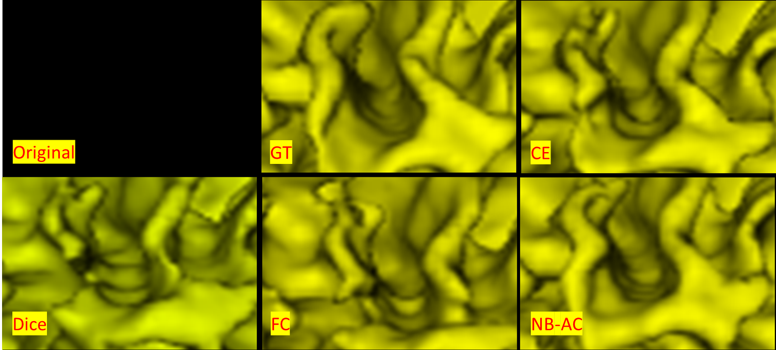
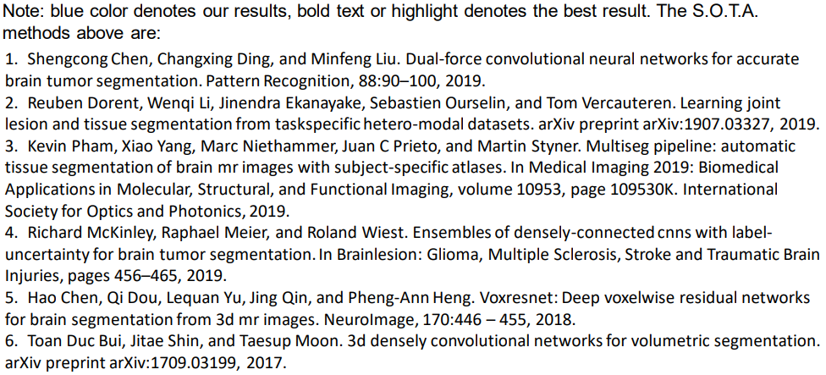
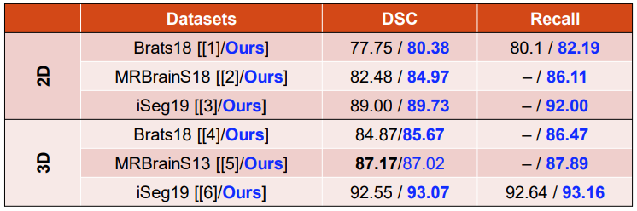
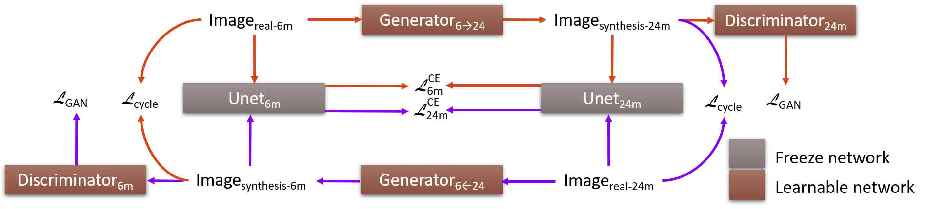
Active Contour Unet with Transfer Learning for Medical Image Segmentation
Different tissues segmentation has been considered as one of the most challenging works in medical image processing (the problem considered here is for the brain), even with the effective support of deep learning methods. Given the 3D multi-modality MRI images, we have to analyze based on the intensity contrast of these input images. These MRI images will try to capture the brain cross-sectional anatomy under different MRI machine settings at the time of capture, leading to the multi-modality input. The figure below shall illustrate this:
white matter (WM)
input
grey matter (GM)
volumetric data
multi-modality input
cerebropinal fluid (CSF)
task
analyze topological structure
segment lesions
As shown above, the two main tasks here in brain image segmentation are to (1) distinguish different parts of the human brain (e.g. grey matter, white matter, cerebrospinal fluid, etc.) for a deeper understanding of the topological structure and to (2) determine exact pixels of lesion or brain tumors (e.g. whole tumor, core tumor, enhancing tumor). Here, the commonly encountered problems are (1) weak boundary, low contrast, (2) imbalanced data, (3) less annotation. For the corresponding problems, our proposed solutions respectively are (1) attention gate on the edge, (2) focus on the narrow band around the contour under level set energy minimization, (3) transfer learning by GAN. We proposed a loss function named Narrow Band – Active Contour (NB-AC) loss, a combination of solutions 1 and 2, able to use as an objective function and train as an end-to-end network.
However, due to the limitation in the number of available MRI brain images, especially those with ground truth annotations, several tasks suffer the less annotation problem. For these task, for instance in iSeg, we have only a few subjects with labels for the 6-month target dataset, while more are available for 24-month. Hence, we adapt the model from Toan Duc Bui et al. trying to translate image from 24 month to 6 month assuming that the topological structure remain. So, we will first need to train independent 6 month and 24 month AC Unets, then train the CycleGAN Segmentation model. And finally use the translated 24-to-6-month image as an augmentation method for the 6-month Unet.
Narrow Band – Active Contour loss on Unet
Cycle GAN Segmentation
We also conducted several experiments: (1) an level set post-processing method to check whether it is promising on our collected dataset; (2) experiments and comparison of NB-AC loss (with cross-entropy loss, dice score, focal loss) trained using 2D/3D Unet and FCN on three datasets (iSeg 2019, MRBrainS18, BRATS 2018), evaluated with different metrics (dice score coefficient, intersection over union, precision, recall) for an overview performance of the proposed loss, with qualitative and quantitative results as well as the topology view; (3) transfer knowledge from Cycle GAN Segmentation model to the proposed 3D dense Unet with NB-AC loss. The figures on the next pages show the overview of this work. Also, this work is currently under review as "Narrow Band Active Contour Attention Model for Imbalanced-Class and Weak Boundary in Medical Segmentation", at IEEE Transactions on Image Processing, IF: 6.79.
Qualitative result:
iSeg
iSeg topology
MRBrainS
BratS
Quatitative result:
Cycle GAN Segmentation model

